Slide 1
Lecture 04 Divide and Conquer (quicksort)
CSE373: Design and Analysis of Algorithms

Slide 2
Quicksort (Chapter 7)
Follows the divide-and-conquer paradigm.
Divide: Partition (separate) the array A[p..r] into two (possibly empty) subarrays A[p..q–1] and A[q+1..r].
Each element in A[p..q–1] ≤ A[q].
A[q] < each element in A[q+1..r].
Index q is computed as part of the partitioning procedure.
Conquer: Sort the two subarrays by recursive calls to quicksort.
Combine: The subarrays are sorted in place – no work is needed to combine them.
How do the divide and combine steps of quicksort compare with those of merge sort?

Slide 3
Pseudocode
PARTITION(A, p, r)
x = A[r]
2. i = p-1
3. for j = p to r – 1
4. if A[j] ≤ x
5. i = i + 1
6. exchange A[i] with A[j]
7. exchange A[i + 1] with A[r]
8. return i + 1
QUICKSORT(A, p, r)
1. if p < r then
2. q = PARTITION(A, p, r);
3. QUICKSORT (A, p, q – 1);
4. QUICKSORT (A, q + 1, r)
A[p..r]
5
A[p..q – 1]
A[q+1..r]
Partition
5
≤ 5
> 5

Slide 4
Example
p r
initially: 2 5 8 3 9 4 1 7 10 6 note: pivot (x) = 6
i j
next iteration: 2 5 8 3 9 4 1 7 10 6
i j
next iteration: 2 5 8 3 9 4 1 7 10 6
i j
next iteration: 2 5 8 3 9 4 1 7 10 6
i j
next iteration: 2 5 3 8 9 4 1 7 10 6
i j
PARTITION(A, p, r)
x = A[r]
2. i = p-1
3. for j = p to r – 1
4. if A[j] ≤ x
5. i = i + 1
6. exchange A[i] with A[j]
7. exchange A[i + 1] with A[r]
8. return i + 1

Slide 5
Example (Continued)
next iteration: 2 5 3 8 9 4 1 7 10 6
i j
next iteration: 2 5 3 8 9 4 1 7 10 6
i j
next iteration: 2 5 3 4 9 8 1 7 10 6
i j
next iteration: 2 5 3 4 1 8 9 7 10 6
i j
next iteration: 2 5 3 4 1 8 9 7 10 6
i j
next iteration: 2 5 3 4 1 8 9 7 10 6
i j
after final swap: 2 5 3 4 1 6 9 7 10 8
i j
PARTITION(A, p, r)
x = A[r]
2. i = p-1
3. for j = p to r – 1
4. if A[j] ≤ x
5. i = i + 1
6. exchange A[i] with A[j]
7. exchange A[i + 1] with A[r]
8. return i + 1

Slide 6
Partitioning
Select the last element A[r] in the subarray A[p..r] as the pivot – the element around which to partition.
As the procedure executes, the array is partitioned into four (possibly empty) regions.
A[p..i] — All entries in this region are ≤ pivot.
A[i+1..j – 1] — All entries in this region are > pivot.
A[r] = pivot.
A[j..r – 1] — Not known how they compare to pivot.

Slide 7
Complexity of Partition
PartitionTime(n) is given by the number of iterations in the for loop.
Θ(n) : n = r – p + 1.
PARTITION(A, p, r)
x = A[r]
2. i = p-1
3. for j = p to r – 1
4. if A[j] ≤ x
5. i = i + 1
6. exchange A[i] with A[j]
7. exchange A[i + 1] with A[r]
8. return i + 1

Slide 8
Algorithm Performance
Running time of quicksort depends on whether the partitioning is balanced or not.
Best case: occurs when the recursion tree is always balanced
Worst case: occurs when the recursion tree is always unbalanced
Average case: computed by using expected value of running time assuming that the pivot elements are randomly distributed

Slide 9
Best-case Partitioning
Size of each subproblem ≈ n/2.
Recurrence for running time
T(n) ≤ 2T(n/2) + PartitionTime(n)
= 2T(n/2) + Θ(n), just like MergeSort
T(n) = Θ(n lg n), like MergeSort
QUICKSORT(A, p, r) //initial call: QuickSort(A,1,n) …. Takes T(n) time (let)
1. if p < r then …… Θ(1)
2. q = PARTITION(A, p, r); ….. Θ(n)
3. QUICKSORT (A, p, q – 1); ….. T(n/2)
4. QUICKSORT (A, q + 1, r); ….. T(n/2)

Slide 10
Recursion Tree for Best-case Partition
cn
cn
cn/2
cn/2
cn
lg n
cn/4
cn/4
cn/4
cn/4
cn
c
c
c
c
c
c
cn
Total : O(n lg n)

Slide 11
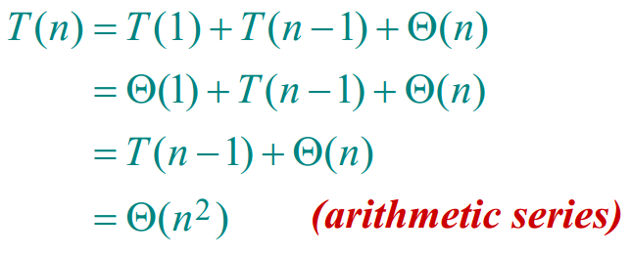
Worst-case of quicksort
Worst-Case Partitioning (Unbalanced Partitions):
Occurs when every call to partition results in the most unbalanced partition.
Partition is most unbalanced when
Subproblem 1 is of size n – 1, and subproblem 2 is of size 0 or vice versa.
pivot ≥ every element in A[p..r – 1] or pivot < every element in A[p..r – 1].
Every call to partition is most unbalanced when
Array A[1..n] is sorted or reverse sorted!
One side of partition always has one element.

Slide 12
Expected Running time of QuickSort
We can show that the expected running time of QuickSort is O(n lg n), same as that of MergeSort.
So, even though, the worst case running time of QuickSort is worse than that of MergeSort, its Average running time is comparable to that of MaergeSort.
For the sake of simplicity, we omit the mathematical details of the calculation of expected running time of QuickSort.
In practice, QuickSort is much faster than MergeSort

Slide 13
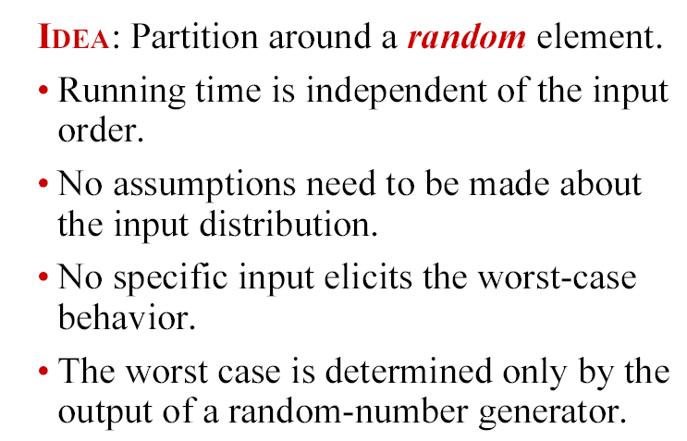
Randomized quicksort
How can we ENSURE that each element of A are equally likely to be the pivot?

Slide 14
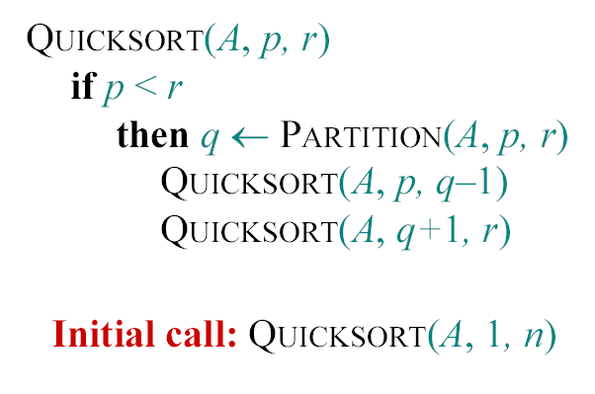
Randomized quicksort
Standard Problematic Algorithm :

Slide 15
Randomized quicksort
RANDOMIZED-PARTITION (A, p, r)
i←RANDOM(p, r)
exchange A[r]↔A[i]
return PARTITION(A, p, r)
RANDOMIZED-QUICKSORT (A,p,r)
if p<r
then q←RANDOMIZED-PARTITION (A, p, r)
RANDOMIZED-QUICKSORT (A, p, q-1)
RANDOMIZED-QUICKSORT (A, q+1, r)
In practice, Randomized-QuickSort is much faster than QuickSort

